Slide 1
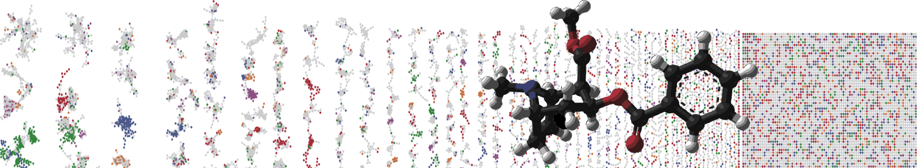


GNPS – LCMS Dashboard
HANDS ON
Mingxun Wang and Daniel Petras
University of California - San Diego

Slide 2
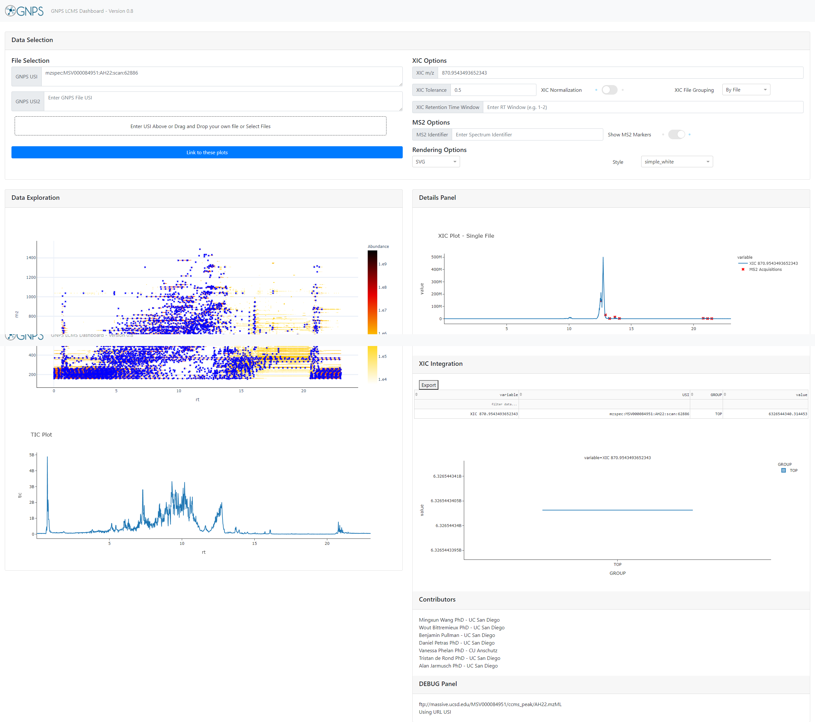

Interactively Exploring LCMS Data
Full LC/MS Mass Spec File
Visualize

Slide 3
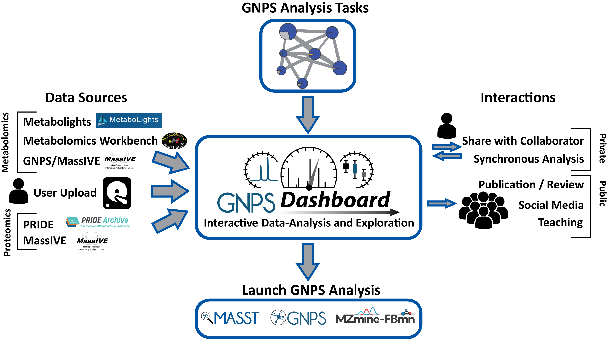
Interactively Exploring LCMS Data

Slide 4
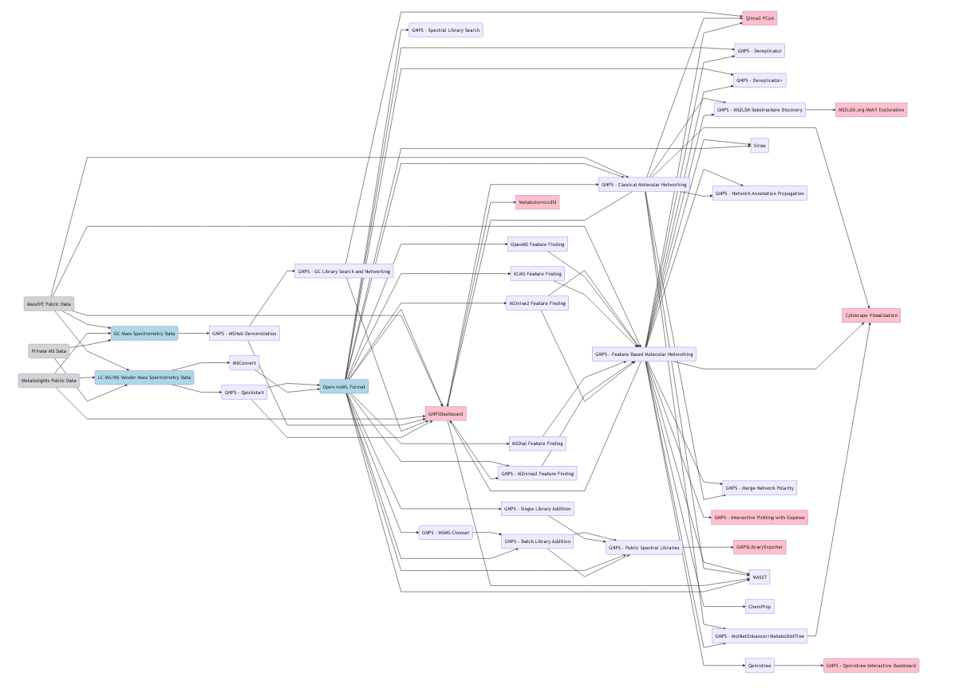
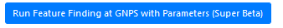
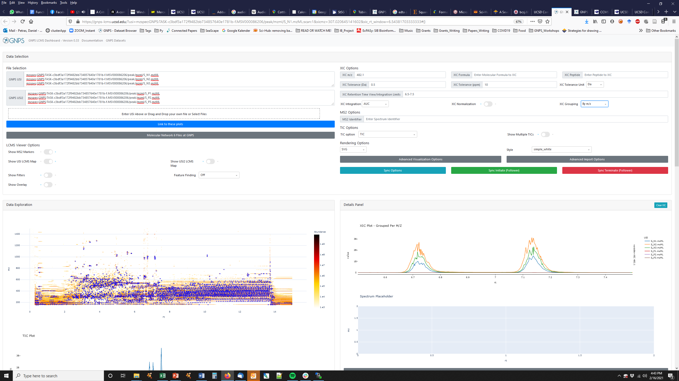
Dashboard in the GNPS Workflows
Classic MN
Feature Finding
FBMN
Data
Dashboard
MASST

Slide 5
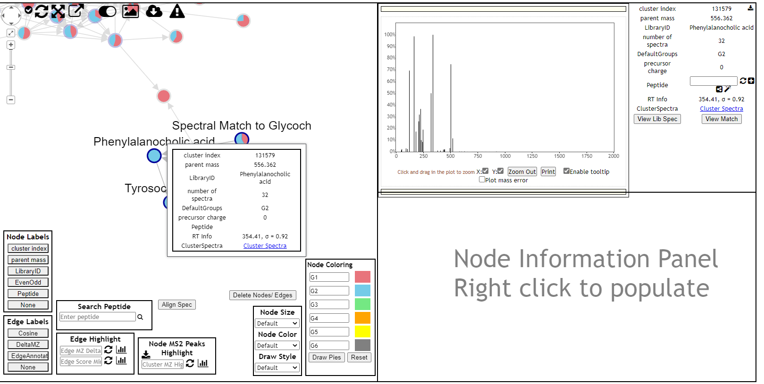
Selecting Data from Classic MN
View Spectra
Click
Interactive Link

Slide 6
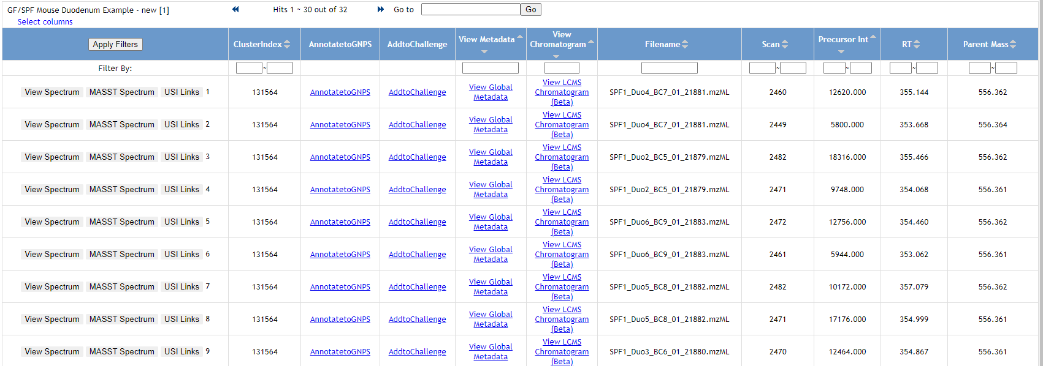
Picking SPF File to Visualize
This tables lists all MS/MS in the original mzML data,
Now lets check the Extracted Ion Chromatogram for the SPF Conjugated Cholic Acid
Interactive Link

Slide 7
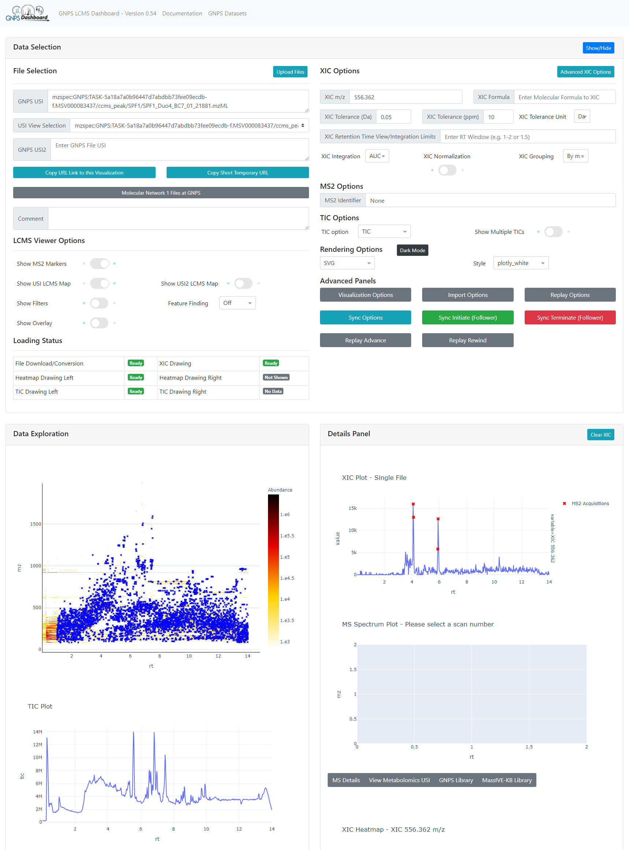
1.
2.
Data Selection
XIC Plotting Options
2D LCMS Heat Map
TIC Plot
XIC Plots/MS2 Plots
3.
5.
4.
Example Link

Slide 8
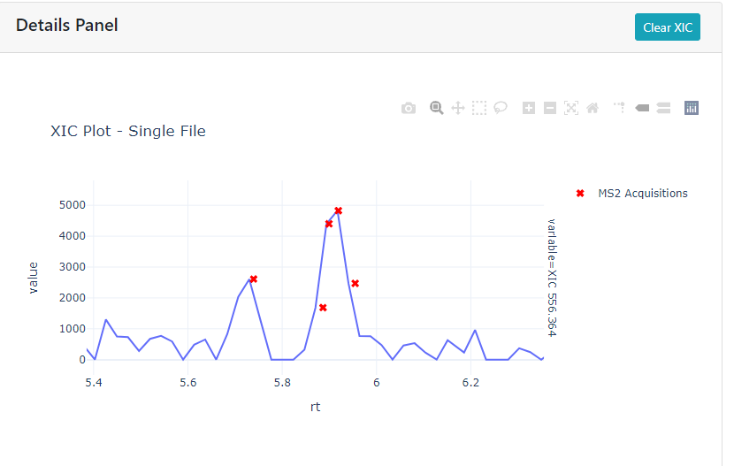
Phenylaline Conjugated Cholic Acid
556.362 m/z @ 5.9 min
Interactive Link

Slide 9
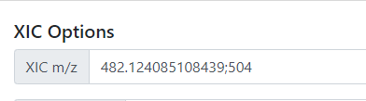
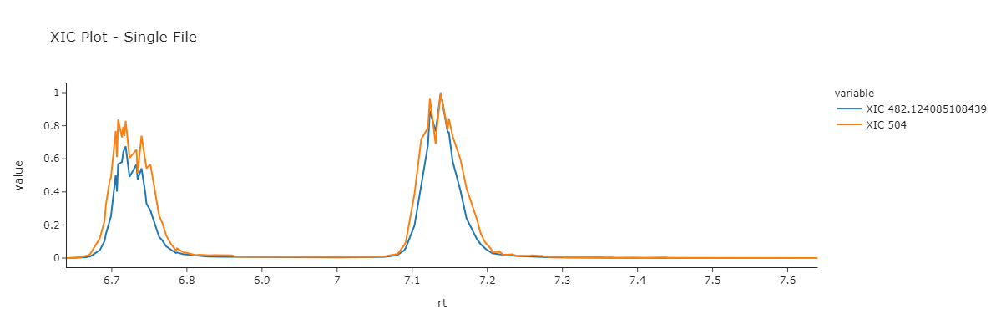
XIC on Multiple m/z
Example Link

Slide 10
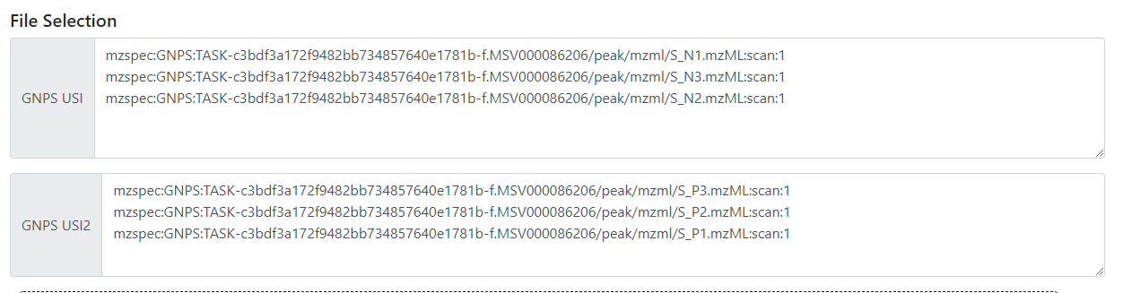
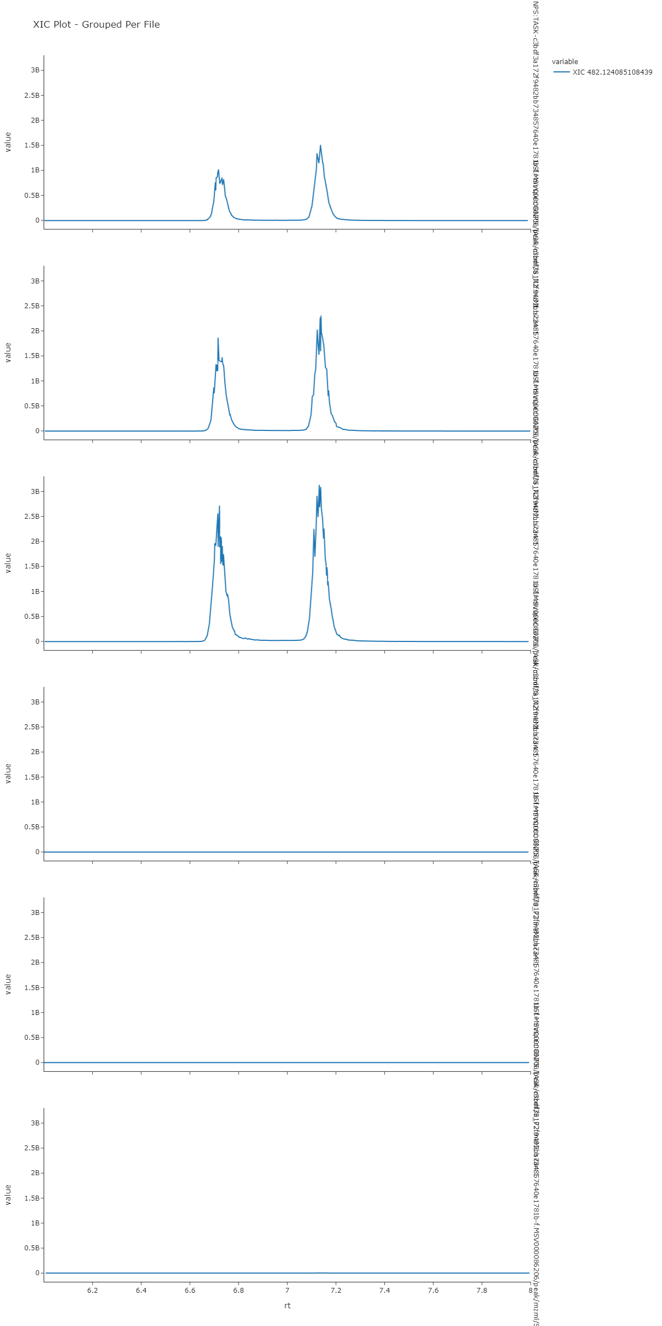
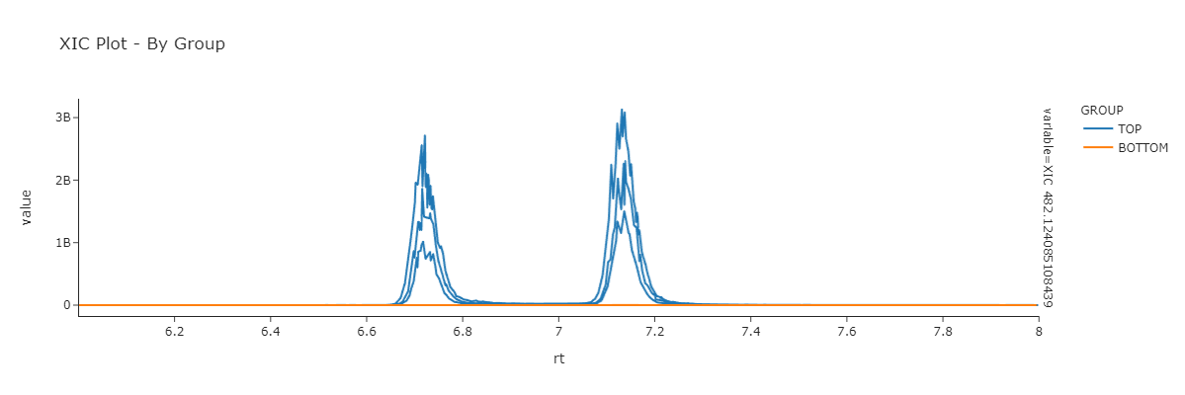
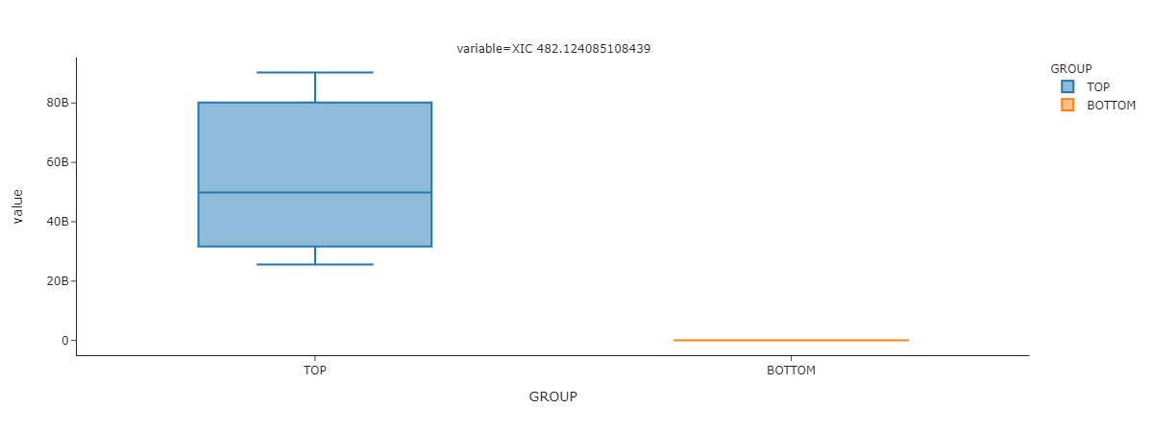
XIC Comparison on Multiple Files
Example Link

Slide 11

Synchronization in the GNPS Dashboard
URL Sharing
Leader/Follower
Full Sync
URL Linking
Follower
Auto-sync
Leader
Follower

Slide 12
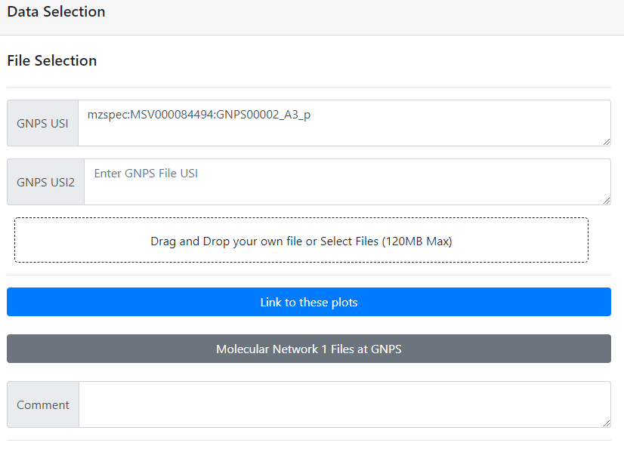
Synchronization in the GNPS Dashboard
URL Sharing

Slide 13
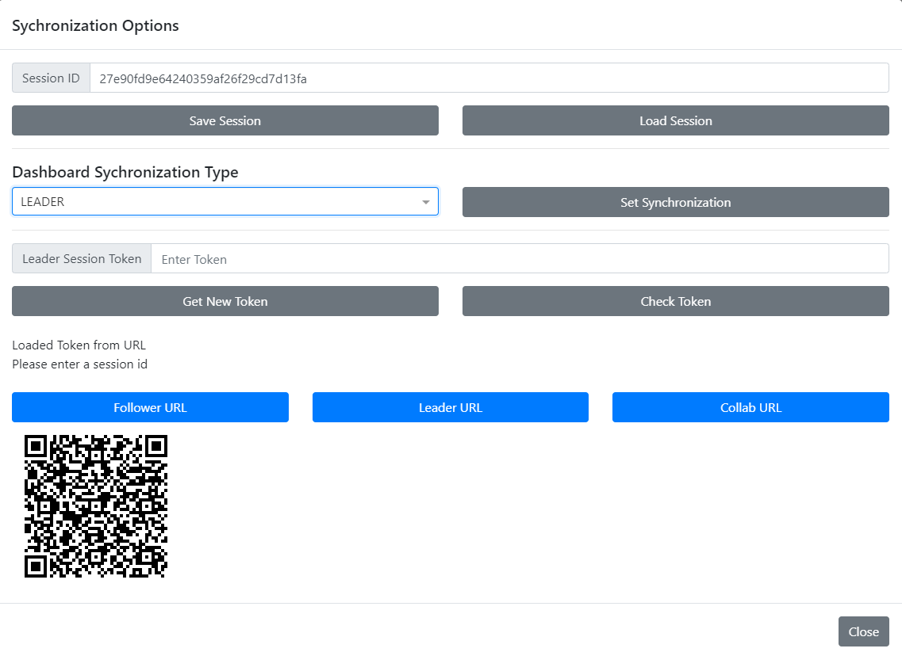
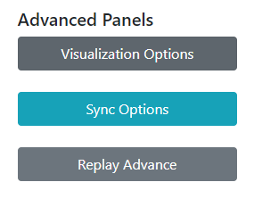
Synchronization in the GNPS Dashboard
Leader/Follower
Share with followers

Slide 14

Synchronization in the GNPS Dashboard
Let’s try it!
Follower Link
Notes:
Leader Link:
https://gnps-lcms.ucsd.edu//?sychronization_session_id=27e90fd9e64240359af26f29cd7d13fa&synchronization_type=LEADER&synchronization_leader_token=5f6cc0da06824c83ab64e635907d1ee7

Slide 15
Questions, Problems or Bugs?
Documentation: https://ccms-ucsd.github.io/GNPSDocumentation/
Forum: https://groups.google.com/forum/#!forum/molecular_networking_bug_reports
Ming Wang (miw023@ucsd.edu)
Daniel Petras (functionalmetabolomics@gmail.com)

